Slide 1
Introduction to JavaScript

Slide 2
What is JavaScript?
Object-based SCRIPTING language
It does not need pre-processing (e.g. compiling) before being run.
JavaScript is NOT an object-oriented programming language
Does not support class-based inheritance
Works with the objects associated with a Web page document
the window
the document
the elements
such as forms, images, hyperlinks, etc

Slide 3
Common Uses of JavaScript
Display a message box
Select list navigation
Edit and validate form information
Create a new window with a specified size and screen position
Image Rollovers
Status Messages
Display Current Date
Calculations

Slide 4
Some Examples of JavaScript

Slide 5


Writing Into HTML Output

Slide 6
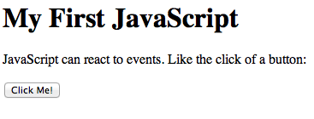
Reacting to Events (Pop up box)

Slide 7
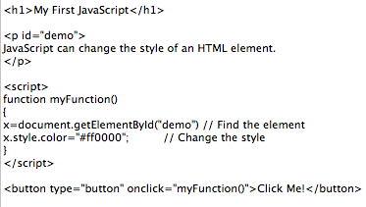
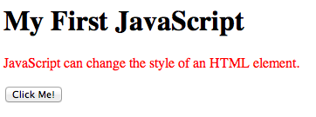
Changing HTML Styles

Slide 8
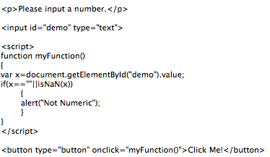

Validate Input

Slide 9
Adding JavaScript to a Webpage

Slide 10
JavaScript with Input & Output Step 1: Use <script> tags
<script>
</script>

Slide 11
Step 2: Welcome the user!
<script>
alert("Hello, World!");
</script>

Slide 12
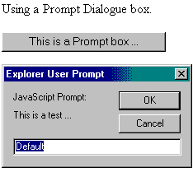
Step 3: Ask the user to input a number
<script>
alert("Hello, World!");
number=prompt(“Enter a number”);
</script>
Enter a number:

Slide 13
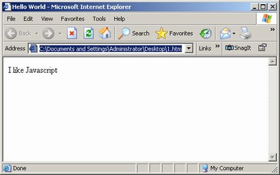
Step 4: Print out the number entered
<script>
alert("Hello, World!");
number=prompt(Enter a number”);
document.write (“Number is: " + number);
</script>
Number is: 3

Slide 14
Where does JavaScript tag go?
It can go in either the head or body but ….
Put the scripts at the bottom of the body, if at all possible as the page will load faster
Make it external (in a .js file)

Slide 15
Some other hints
JavaScript statements can be coded on a Web page using two different techniques:
Place JavaScript code between <script> tags
<script>tag must be closed
All JavaScript code goes inside the <script>tags
Any number of <script> tags can be used
Nesting <script> tags is prohibited
Place JavaScript code as part of an event attached to an HTML element

Slide 16
Control Structures
Control structures control the code execution according to a certain criteria
Conditional Statements
Loop Statements

Slide 17
Conditional Statements
if statement (discussed earlier)
switch statement

Slide 18
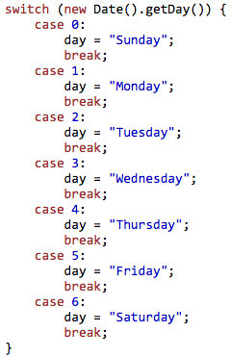

Conditional Statements

Slide 19
Loop Statements
for, while, and do while statements are used
break exits the loop all together
continue skips the current iteration
for statement: for (ini value; end value; incr){ statements }
while statement: while (condition) { statements }
do while statement: do { statements }while (condition)

Slide 20



Loop Statements

